Slide 1
Drupal
Santosh Kalwar
08.09 – 09.09

Slide 2
Drupal Recap
Previously
We improved our custom theme a bit
Devel generate, Views practices
Also created a custom module with hooks example
You did group work on several contrib modules

Slide 3
Today Topics
Drupal with React
Hello React! With Drupal
Drupal Configurations: drush cex, cim
Group work 1:
You work with your group to add react app inside Drupal
Group work 2:
Add REST module inside your drupal
Optional/Extra: After enabling REST module, create a view with the REST export feature
Group work presentation

Slide 4
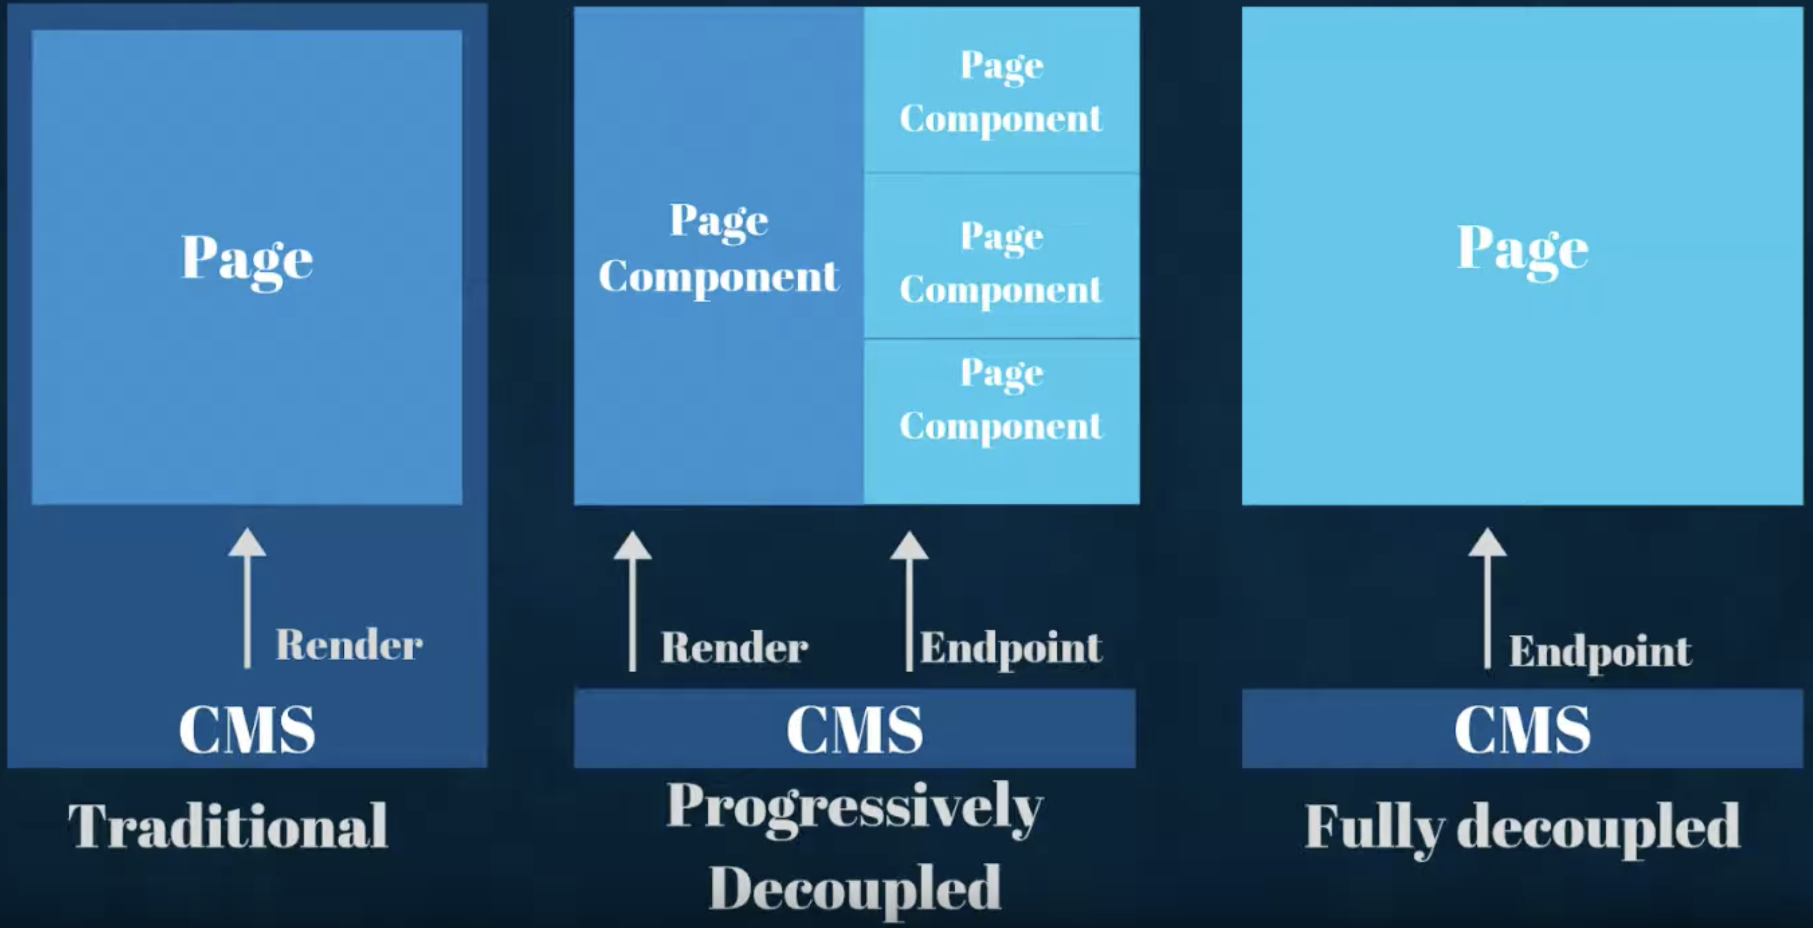
Traditional vs Progressively vs Fully Decoupled
React and Drupal can be used together in two different ways: fully decoupled, also known as headless, or progressively decoupled.

Slide 5
Hello, React! With Drupal 1/3
You can embed React with either theme or module
Write the info.yml file and enable the new theme (Appearance→Install and set as default)
Create a js/src/ directory in your theme for your JavaScript if you haven't already, e.g. /themes/react_drupal_theme/js/src
Create a new file index.jsx
ReactDOM.render(
<h1> Hello React - Drupal</h1>,
document.getElementById('react-app')
);
Setting up JS build package manager (e.g. Parcel, webpack)
Install React, webpack, and Babel
Go to your terminal and from root directory of your theme or module e.g. /theme/react_drupal_theme/
Create package.json file e.g. npm init -y
Install dependencies:
npm install --save react react-dom prop-types
npm install --save-dev @babel/core @babel/preset-env @babel/preset-react babel-loader webpack webpack-cli
10. Configure webpack with webpack.config.js file

Slide 6
Hello, React! With Drupal 2/3
Create a webpack.config.js file in the root of your theme, see an example
webpack.config.js uses isDevMode variable to change the configuration depending on wheather you are running ”development” mode or ”production” mode.
Configure Babel with .babelrc file
Inside /themes/react_drupal_theme/.babelrc, add following:
{ "presets": [
"@babel/preset-env",
"@babel/preset-react"
] }
We need to define a drupal asset library that tells Drupal where to find our JS files, create themes/react_drupal_theme.libraries.yml file and add following:
react_app:
version: VERSION
js:
js/dist/main.min.js: {minified: true}
In your theme directory, create the js/dist folder
Add some helper scripts e.g. start and build script
8. Now you can run the commands e.g. npm run start, build

Slide 7
Hello, React! With Drupal 3/3
Add a .gitignore file in the root of your theme
node_modules
/dist_dev/ -- optional
Let us override page.html.twig template and add a <div> into the sidebar so our react app will render in the sidebar above any configured blocks
Copy core/themes/bartik/templates/page.html.twig into /themes/react_drupal_theme/templates directory
Clear the drupal cache
Find section “sidebar-first” and remove if page.sidebar_first conditional so that sidebar is always rendered and add <div id=“react-app” class=“block”>React app loads here</div> after <aside class="section" role="complementary">
Include asset library by updating react_drupal_theme.info.yml
libraries:
- react_hello/react_app
Clear the drupal cache

Slide 8
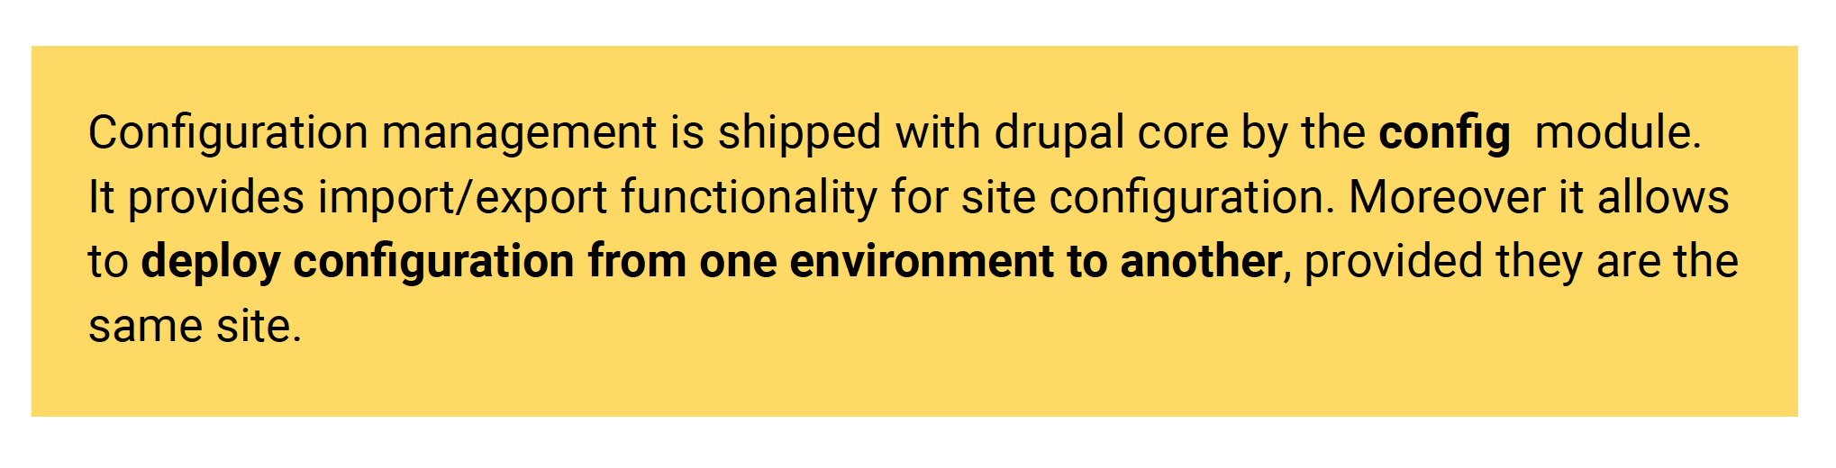
Drupal Configuration
We can export the configuration to yaml-files in a folder we choose. I prefer to keep configuration in the root, so we should see a new folder e.g. /config in the root of our project

Slide 9
Drupal Configuration
We define the configuration folder in settings.php.. Look for the
$settings['config_sync_directory']
and set it to:
$settings['config_sync_directory'] = './config/global';
Export all our current configuration with drush (drush cex is an alias for drush config-export):
drush cex
You should now see a new folder e.g. /config

Slide 10
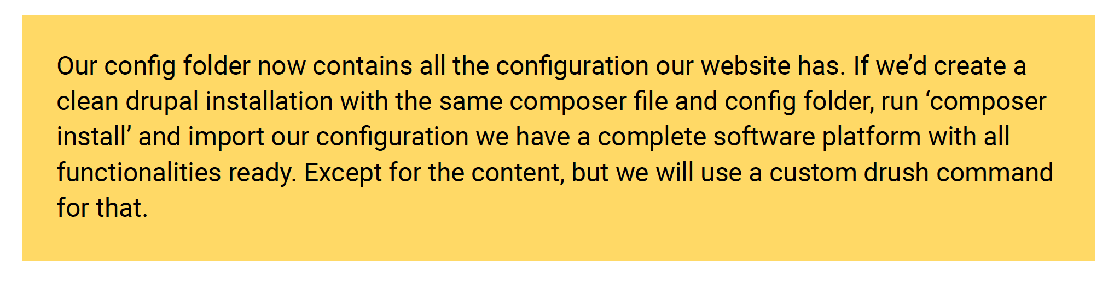
Drupal Configuration
We use configuration management for bringing configuration from website staging to website production.

Slide 11
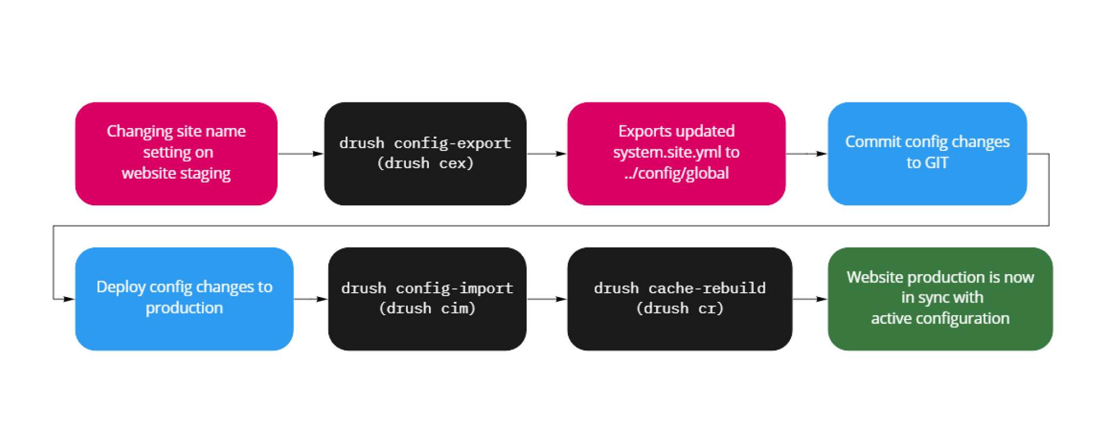
Drupal Configuration

Slide 12
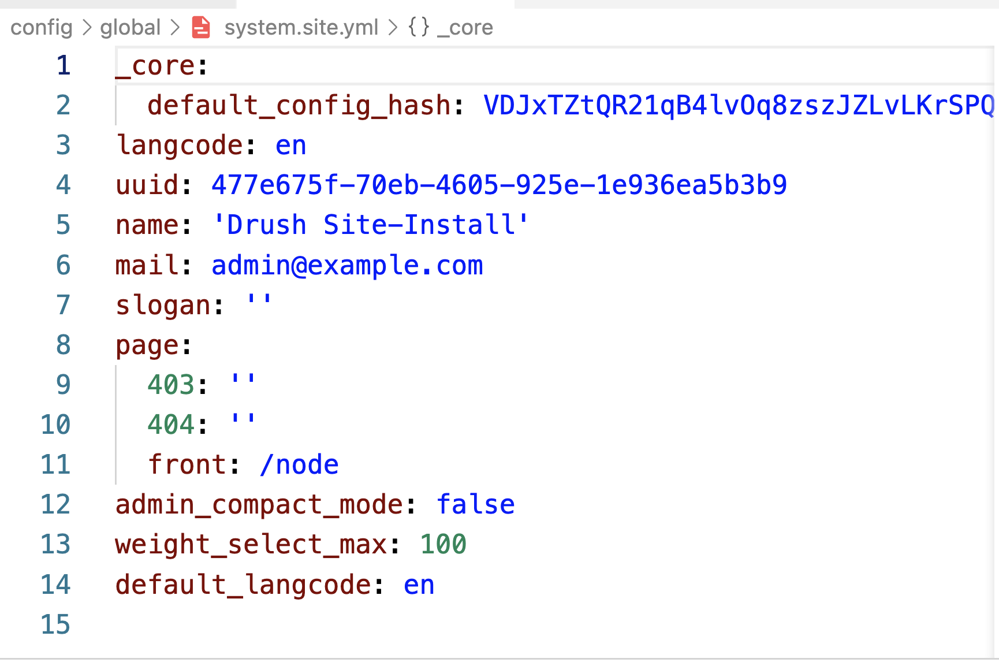
Drupal Configuration
The structure of a configuration file, for example system.site.yml, looks like this:

Slide 13
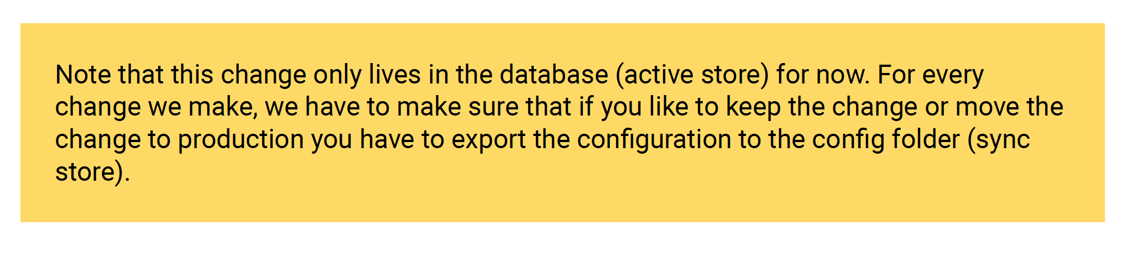
Drupal Configuration
Let’s change the slogan and see what happens. We can log in and fill it in at /admin/config/system/site-information, but we can also do it in the terminal with drush:
lando drush cset system.site slogan 'Awesome platform’
Now run: lando drush cex
In production we can then run:
lando drush drupal cim

Slide 14
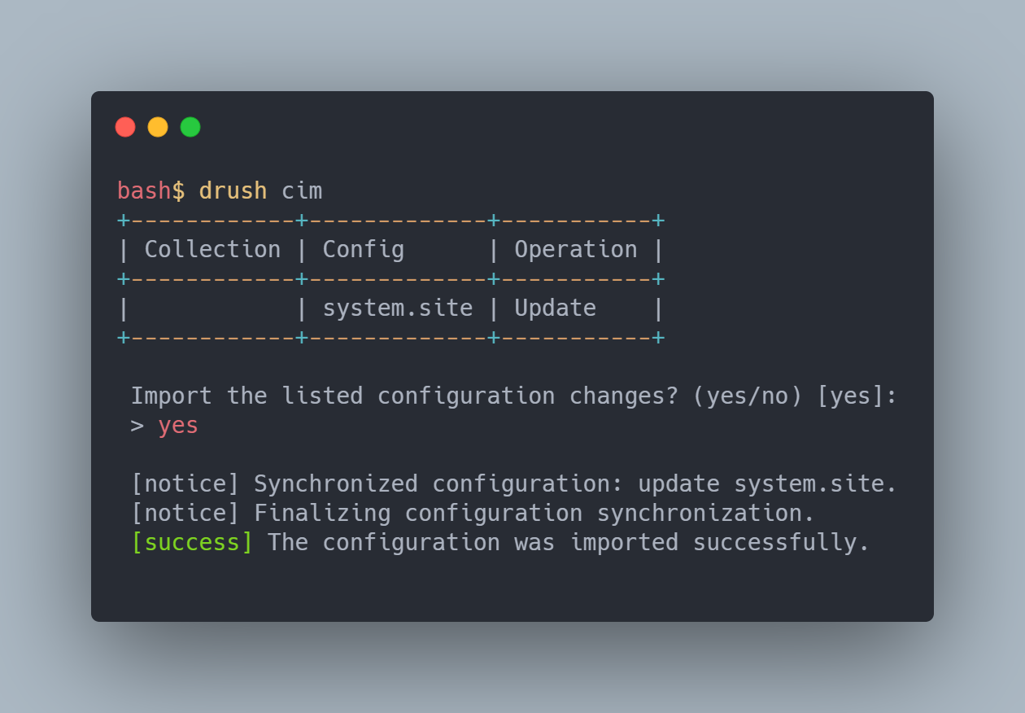
Drupal Configuration

Slide 15
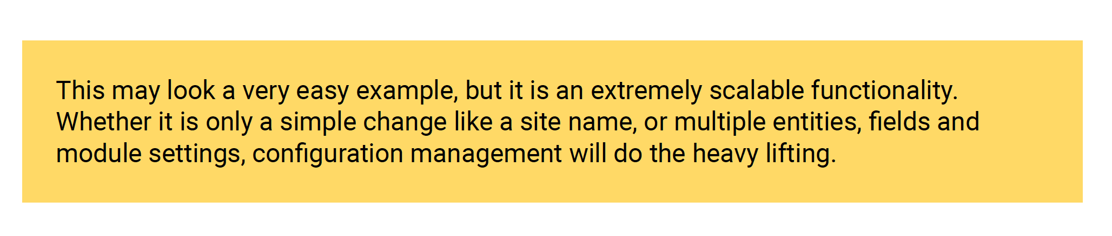
Drupal Configuration
Putting configuration in yaml files is a smart thing to do.
By running a config import command on production, all the new settings get imported and the site is updated.

Slide 16
Creating custom configuration settings
Drupal core and (almost) every module come with configuration files. Most of these have settings that can be edited in the /admin/config section of the site.
lando drush drupal generate:form:config --uri=mysite.local
First, add a module to custom/modules with the following structure
Name your module e.g. “offer”, after that enable the module
lando drush en offer –y

Slide 17
Creating custom configuration settings
We add a file offer/src/Form/CustomConfigForm.php to build the config form.
We will start from a default extension of ConfigFormBase() and make sure the value gets saved to the proper configuration file key in the submitForm() function.
To the buildForm() method, I add a section for saving a textarea with a snippet.

Slide 18
Creating custom configuration settings
We now need to add offer.links.menu.yml to add the menu links in our back-end.
Clear caches and head over to /admin/config

Slide 19
Creating custom configuration settings
When we save a value, e.g. GTM-123456, and export our configuration, we’ll see a file called offer.customconfig.yml containing a key: ‘tagmanager’.
lando drush cex
Creating custom configuration gives good insight in the behavior of configuration.

Slide 20
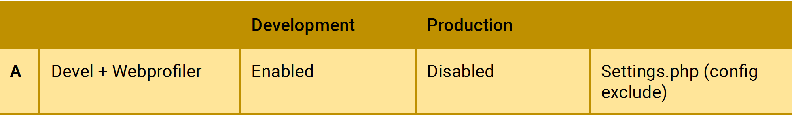
Different configuration per environment
We talked about the webprofiler module in an earlier section.
This is typically something we only want in a development environment.
But there are more use cases where the difference between configurations matters.

Slide 21
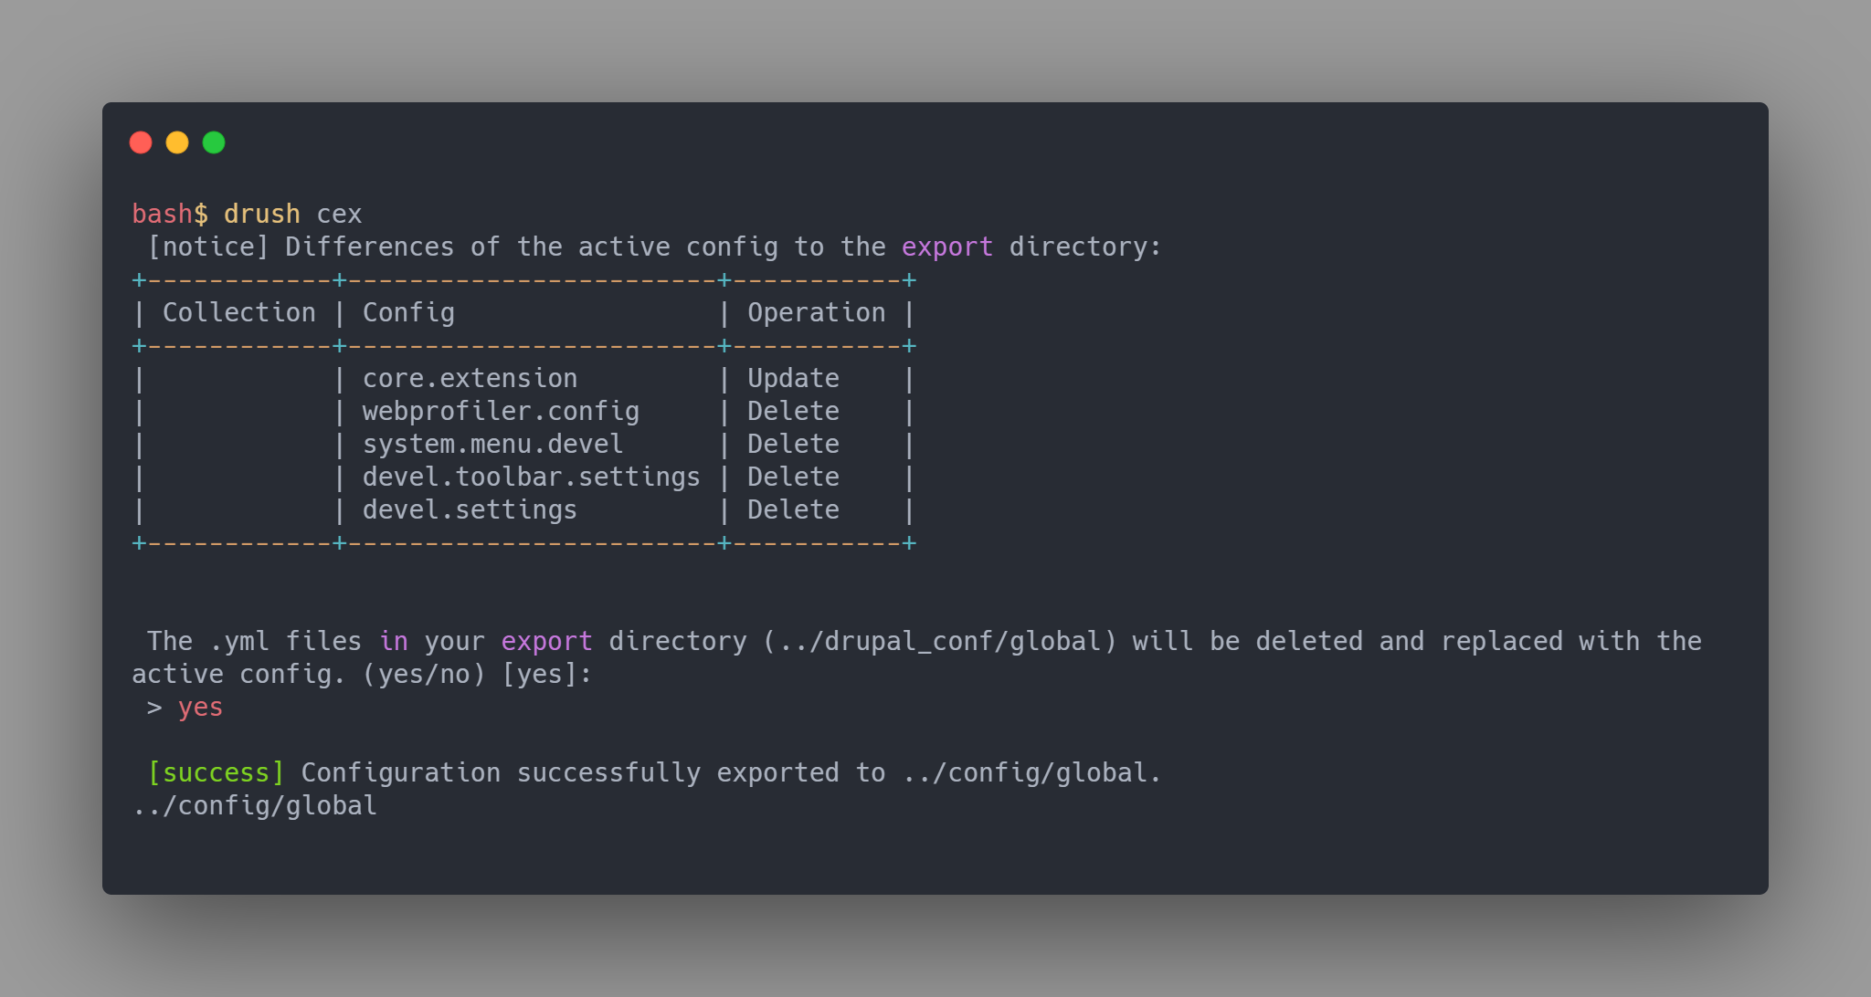
Scenario A: Install a module on development, but not on production
The first step is to install devel and webprofiler module and make sure your sync store is up-to-date by doing: lando drush config-export -y or lando drush cex –y
Then add this to your settings.php file:
$settings['config_exclude_modules'] = ['devel', 'webprofiler’];
After you’ve setup the modules you would like to exclude from your configuration,
export your config again:

Slide 22
Scenario A: Install a module on development, but not on production
You see that all of the configuration that was added by devel and webprofiler gets removed from the sync store. On a production site, there will be no devel and webprofiler.
We could go further and also make sure there is no devel module in our modules folder on production. For this, we would want to exclude it from our composer.json file by using the --dev flag. We would do the following. Note that it is best to do this while setting up your environments the first time:
$ composer require --dev drupal/devel
This results in those dependencies being added into the composer.json file under
require-dev:
"require-dev": {
"drupal/devel": "^4.0"
}

Slide 23
Group work 1
You work with your group to add a simple react app inside Drupal
Please don’t use the “hello world” example that we just did together.
Feel free to experiment and fail – that is how you learn!

Slide 24
Group work 2
Install and use REST module inside your drupal
- Check do you have REST UI, RESTful Web Services in your Drupal, if yes just install them
- Click on Configuration → Web services → REST
- Enable resource name “Content” with path /node/{node}: GET, POST, PATCH, DELETE
- Can you use GET method from POSTMAN
Optional/Extra: After enabling the REST module, create a view with the REST export settings feature for your “Content”
https://localhost:YOURPORT/node/rest?_format=json
- Can you use GET method from POSTMAN

Slide 25
Group presentation
Group presentation will start when every team is ready
Max 5-10 minutes per group
Others will evaluate the presentation and provide feedback on its Learning→ Group work results.
Ask questions and answers
Note: Remember not to vote for your group
Upload the slides in the Group work folder in itsLearning
Keep the presentation short and unique
(Please try to avoid repetition)

